Slide 1
LASER

Slide 2
LASER
Light Amplification by Stimulated Emission of Radiation
Characteristics or Properties of LASER
Coherence
High Directionality
High Intensity
High Monochromaticity
LASER light is highly powerful and capable of propagating over long distances and are not absorbed easily by water.

Slide 3
Processes involved in Laser Production
ABSORBTION
EMISSION
SPONTANEOUS EMISSION
STIMULATED EMISSION
POPULATION INVERSION
PUMPING

Slide 4
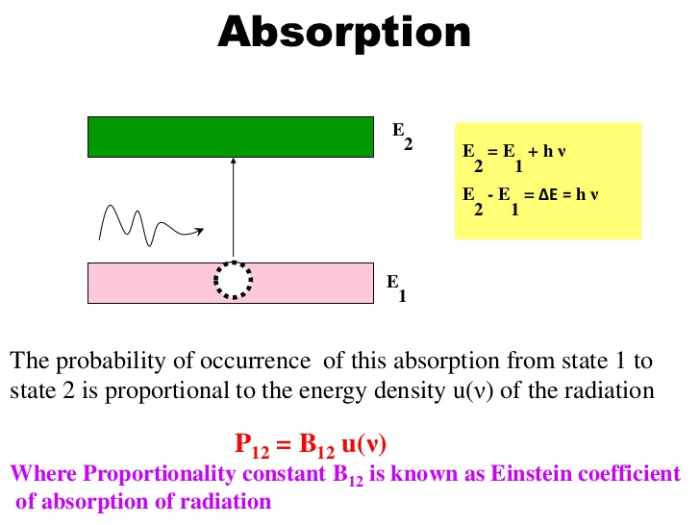

Slide 5
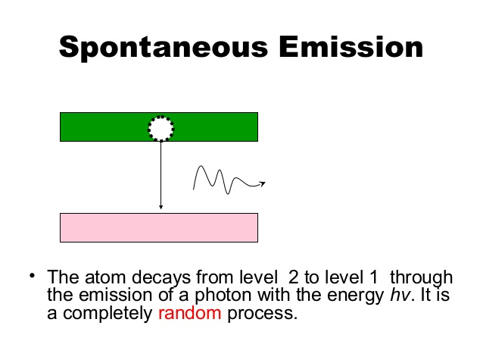

Slide 6
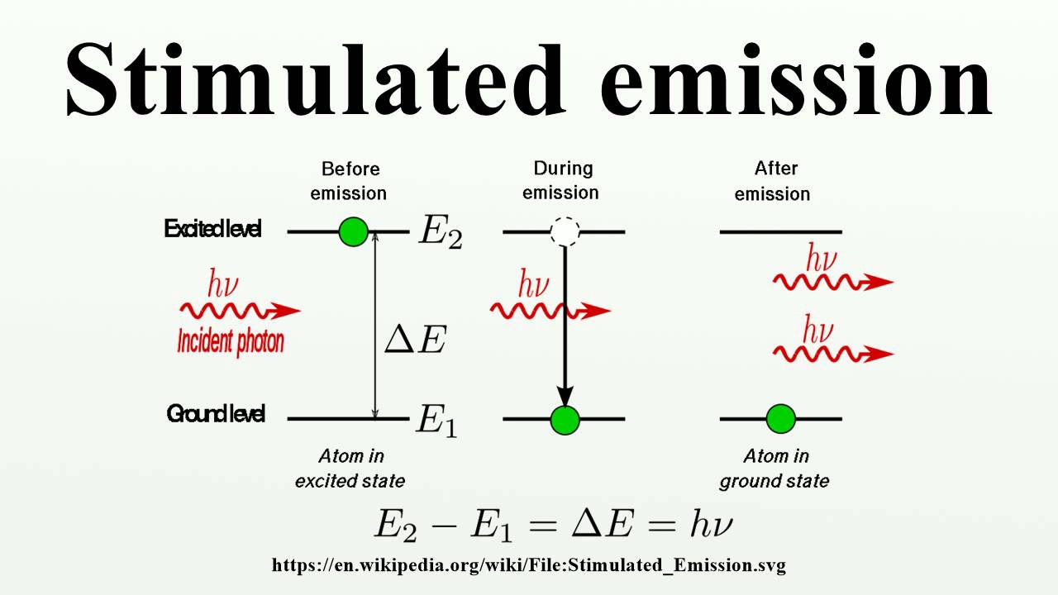

Slide 7
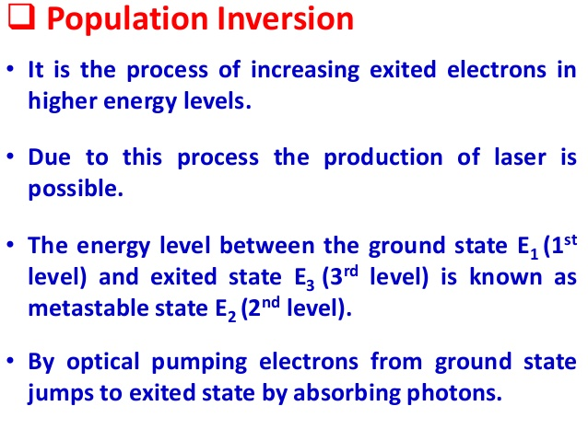

Slide 8
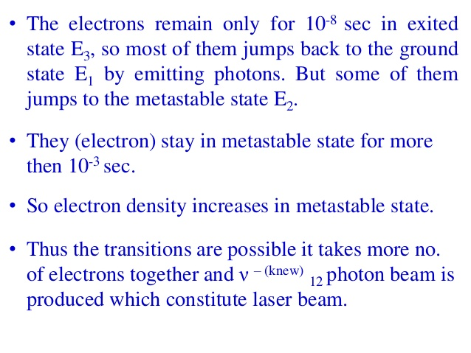

Slide 9
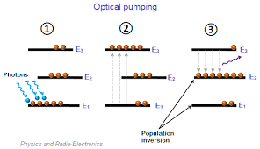

Slide 10
PUMPING
Laser pumping is the act of energy transfer from an external source into the gain medium of a laser. The energy is absorbed in the medium, producing excited states in its atoms.
a) Optical pumping: In this, the population inversion is achieved by means of light energy delivered from appropriate pumping source such as gaseous
discharge or flash tubes. For example, in ruby laser, xenon flash tube is used.
b) Electric discharge: pumping: this type of pumping accomplished by means of intense electrical discharge in the medium and is particularly suited to gas media like He-Ne laser and CO₂ laser. The electric discharge converts the gas into a plasma where active centers collide in elastically with free electrons and population inversion is achieved.
c) Chemical pumping: It raises active centres into the higher levels by means of suitable exothermal chemical reactions in the active medium.
d) Heat pumping: In this type of pumping, the active material is first brought to a high temperature then rapidly cooled down.

Slide 11
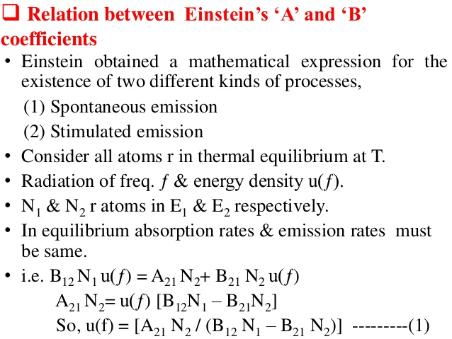

Slide 12
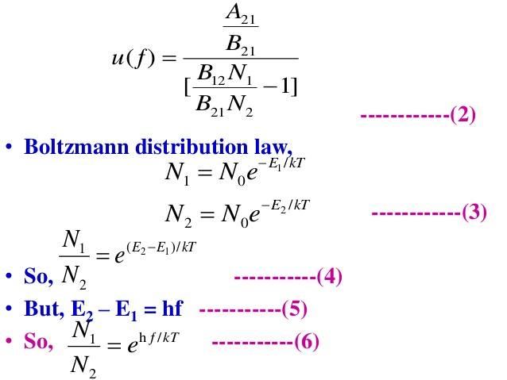

Slide 13
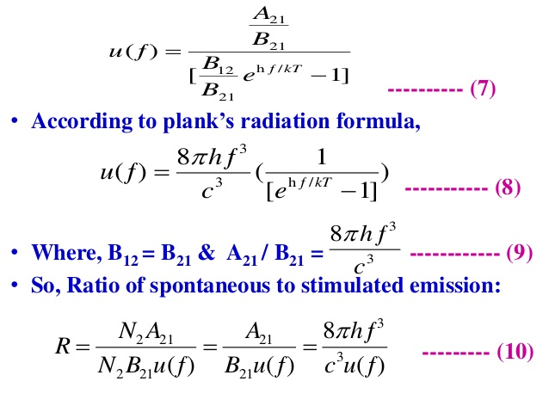

Slide 14
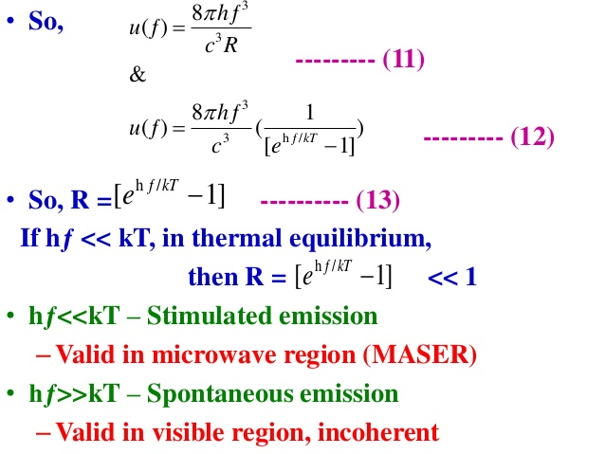

Slide 15
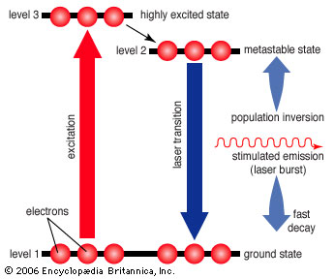
Three-level laser
A burst of energy excites electrons in more than half of the atoms from their ground state to a higher state, creating a population inversion. The electrons then drop into a long-lived state with slightly less energy, where they can be stimulated to quickly shed excess energy as a laser burst, returning the electrons to a stable ground state.
Three-level laser
A burst of energy excites electrons in more than half of the atoms from their ground state to a higher state, creating a population inversion. The electrons then drop into a long-lived state with slightly less energy, where they can be stimulated to quickly shed excess energy as a laser burst, returning the electrons to a stable ground state.

Slide 16
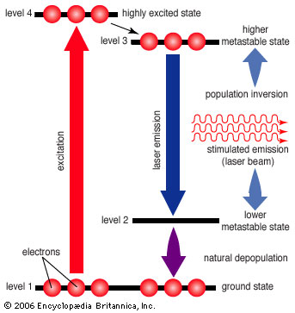
FOUR LEVEL PUMPING
A sustained laser beam can be achieved by using atoms that have two relatively stable levels between their ground state and a higher-energy excited state. As in a three-level laser, the atoms first drop to a long-lived metastable state where they can be stimulated to emit excess energy. However, instead of dropping to the ground state, they stop at another state above the ground state from which they can more easily be excited back up to the higher metastable state, thereby maintaining the population inversion needed for continuous laser operation.

Slide 17
DISCUSSION
Why two level pumping is not possible?
Which one is better three level pumping or four level pumping ?

Slide 18
1.Population inversion is a necessary step in the workings of a standard model. The only way out is to use a third METASTABLE STATE to solve the problem. A two level pumping is not suitable for obtaining population inversion.
The life span , for which atoms have to stay at upper energy level E₂, must be longer for achieving population inversion condition. According to Heisenberg uncertainty principle,
∆E.∆t≥ђ
∆t will be longer if ∆E is smaller,
that is, E₂ is narrow. If ∆E is smaller, the pumping efficiency is smaller, As a consequence of which less number of atom excited . Though a sharp energy level supports the population inversion , enough population cannot be excited to level E₂ in the view of small . The result is that the upward transitions would be accompanied by premature downward stimulated transitions and the population in level E₂ would not accumulate to the required extent.

Slide 19
Four level pumping is better than three level pumping because
The laser output is continuous in the case of four level, but it is in the form of pulse in the three level laser.
Three Level laser requires high power pumping source, whereas four level laser requires low power pumping source like electric discharge.
Efficiency of four level laser is more than three level laser.
The defects due to crystalline imperfections are also present in the laser. But it is not so in the four level laser.

Slide 20
Components of Laser
Active Medium : The active medium is the collection of ions, atoms or molecules in which the stimulated emission occurs. It can be either solid, liquid , gas or semiconductor material. The wavelength of the laser produced depends on the type of active medium.
e.g.: Ruby Laser contains ruby rod with Al and Cr ions as active medium
He-Ne Laser is having Ne ions as active medium
2. Pumping Agent: This is the device used to impart or put energy to the active medium. The process of imparting energy to the active medium is called as pumping.
eg: Xenon light in Ruby Laser
3. Optical Resonator : An optical cavity, resonating cavity or optical resonator is an arrangement of mirrors that forms a standing wave cavity resonator for light waves. Optical cavities are a major component of lasers, surrounding the gain medium and providing feedback of the laser light.

Slide 21
He-Ne Laser
Helium-Neon laser is a type of gas laser in which a mixture of helium and neon gas is used as a gain medium. Helium-Neon laser is also known as He-Ne laser.
Helium-neon laser construction
The helium-neon laser consists of three essential components:
Pump source (high voltage power supply): In helium-neon lasers, a high voltage DC power supply is used as the pump source. A high voltage DC supplies electric current through the gas mixture of helium and neon.
Active medium : The gain medium of a helium-neon laser is made up of the mixture of helium and neon gas contained in a glass tube at low pressure. The gas mixture is mostly comprised of helium gas. Therefore in order to achieve population inversion, excitation of helium atoms is done primarily. In He-Ne laser, neon atoms are the active centre and have energy levels suitable for laser transitions while helium atoms help in exciting neon atoms.
Resonating cavity: The glass tube (containing a mixture of helium and neon gas) is placed between two parallel mirrors. These two mirrors are silvered or optically coated.

Slide 22
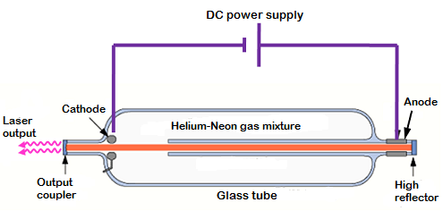
Construction:
Mixture of He and Ne gases taken in a glass tube
The tube is fitted with cylindrical cathode and smaller anode
Optical resonator is the couple of mirrors at the two ends of the tube

Slide 23
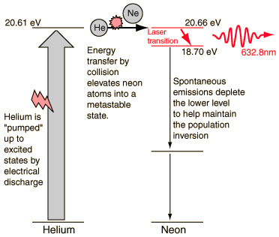
Working

Slide 24
EXPERIMENT ON WAVELENGTH DETERMINATION

Slide 25
Modes of Vibration of CO2

Slide 26
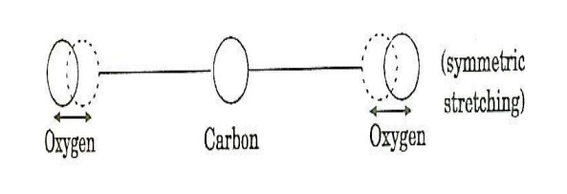
Symmetric stretching mode
In this mode of vibration, carbon atoms are at rest and both oxygen atoms vibrate simultaneously along the axis of the molecule departing or approaching the fixed carbon atoms.

Slide 27
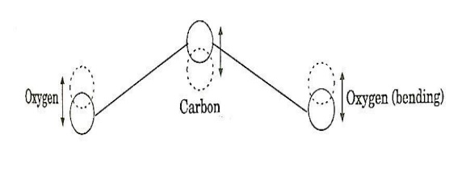
Bending Mode
In this mode the molecules of oxygen and carbon atoms vibrate perpendicular to the molecular axis

Slide 28
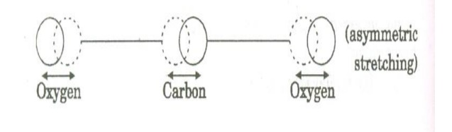
Asymmetric vibration mode
In this the oxygen and carbon atoms vibrate assymetrically i.e. oxygen atoms move in one direction while the carbon atoms in other direction

Slide 29
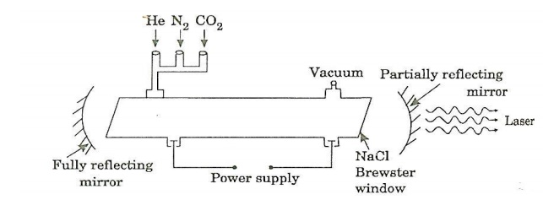
CO2 LASER
In CO2 laser the light production takes place within the molecules of carbon-di-oxide.
The CO2 Laser produces a far infrared beam at 10.6 microns
Construction:

Slide 30
Construction:
It consists of quartz tube 5m long and 2.5 cm in the diameter
The tube is filled with a mixture of CO2 , Helium and nitrogen
Two mirrors one partially reflective and other fully reflective form an optical resonator

Slide 31
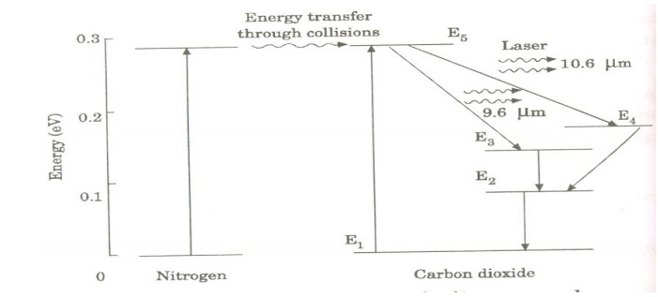

Slide 32
Characteristics:
1. Type: It is a molecular gas laser.
2. Active medium: A mixture of CO2 , N2 and helium or water vapour is used as active medium
3. Pumping method: Electrical discharge method is used for Pumping action
4. Optical resonator: Two concave mirrors form a resonant cavity
5. Power output: The power output from this laser is about 10kW.
6. Nature of output: The nature of output may be continuous wave or pulsed wave.
7. Wavelength of output: The wavelength of output is 9.6μm and 10.6μm

Slide 33
EXPERIMENT ON TRACK WIDTH OF CD

Slide 34
Applications of Laser:
MANUFACTURING (INDUSTRY)
MEDICAL
METEREOLOGY
SPECTROSCOPY
MICROSCOPY
MILITARY
SCIENCE AND TECHNOLOGY
DATA STORAGE
COMMUNICATIONS

Slide 35
EXPERIMENT TO DETERMINE PARTICLE SIZE

Slide 36
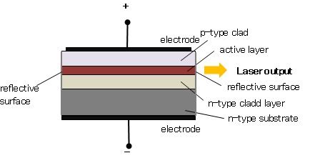
The basic structure of a semiconductor laser is shown in the Figure . The active layer (light emission layer) sandwiched between the p- and n-type clad layers (double heterostructure) is formed on an n-type substrate, and voltage is applied across the p-n junction from the electrodes. Both edges of the active layer has mirror-like surface.When forward voltage is applied, electrons conbine with holes at the p-n junction, and emitt the light. This light is not a laser yet; it is confined within the active layer because the refractive index of the clad layers are lower than that of the active layer. In addition, both ends of the active layer act as a reflecting mirror where the light reciprocates in the active layer. Then, the light is amplified by the stimulated emission process and laser oscillation is generated.
The basic structure of a semiconductor laser is shown in Figure 1

Slide 37
Figure shows the basic construction of semiconductor laser. The active medium is a p-n junction diode made from the single crystal of gallium arsenide. This crystal is cut in the form of a platter having thickness of 0.5μmm. The platelet consists of two parts having an electron conductivity (n-type) and hole conductivity (p-type). The photon emission is stimulated in a very thin layer of PN junction (in order of few microns). The electrical voltage is applied to the crystal through the electrode fixed on the upper surface. The end faces of the junction diode are well polished and parallel to each other. They act as an optical resonator through which the emitted light comes out.

Slide 38
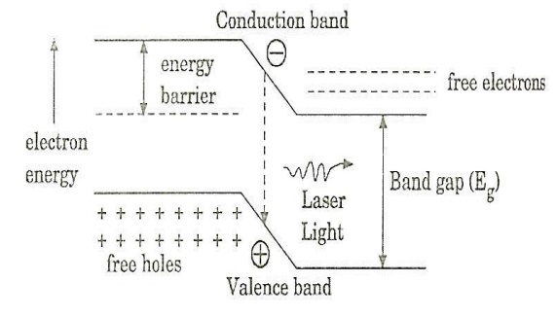

Slide 39
When the PN junction is forward biased with large applied voltage, the electrons and holes are injected into junction region in considerable concentration The region around the junction contains a large amount of electrons in the conduction band and a large amount of holes in the valence band. If the population density is high, a condition of population inversion is achieved. The electrons and holes recombine with each other and this recombination’s produce radiation in the form of light. When the forward – biased voltage is increased, more and more light photons are emitted and the light production instantly becomes stronger. These photons will trigger a chain of stimulated recombination resulting in the release of photons in phase. The photons moving at the plane of the junction travels back and forth by reflection between two sides placed parallel and opposite to each other and grow in strength. After gaining enough strength, it gives out the laser beam of wavelength 8400o A . The wavelength of laser light is given by Where Eg is the band gap energy in joule.

Slide 40
Eg= hc/λ
Characteristics:
1. Type: It is a solid state semiconductor laser.
2. Active medium: A PN junction diode made from single crystal of
gallium arsenide is used as an active medium.
3. Pumping method: The direct conversion method is used for pumping
action
4. Power output: The power output from this laser is 1mW.
5. Natu re of output: The nature of output is continuous wave or pulsed
output.
6. Wavelength of Output: gallium arsenide laser gives infrared radiation
in the wavelength 8300 to 8500o A .
Advantages:
1. It is very small in dimension. The arrangement is simple and compact.
2. It exhibits high efficiency.
3. The laser output can be easily increased by controlling the junction current
4. It is operated with lesser power than ruby and CO2 laser.
5. It requires very little auxiliary equipment
6. It can have a continuous wave output or pulsed output.
Disadvantages:
1. It is difficult to control the mode pattern and mode structure of laser.
2. The output is usually from 5 degree to 15 degree i.e., laser beam has large
divergence.
3. The purity and monochromacity are power than other types of laser
4. Threshold current density is very large (400A/mm2).
5. It has poor coherence and poor stability.
Application:
1. It is widely used in fiber optic communication
2. It is used to heal the wounds by infrared radiation
3. It is also used as a pain killer
4. It is used in laser printers and CD writing and readi

Slide 41
Tutorial 1
Determine the Probabilities of finding a particle trapped in a box of length L in the region from 0.45L to 0.55L for the ground state.
Tutorial 2
1.Why two level Laser is not used for Laser Production?
2.A three level laser emit light at a wavelength of 550 nm .Calculate the energy and momentum of a photon

